Slide 1

MALNAD COLLEGE OF ENGINEERING
HASSAN – 573202, KARNATAKA
(An Autonomous Institute under VTU, Belgaum)
SUB : Mini Project(23IS506)
TOPIC :AI-Powered Class Scheduling System using Django Framework
Guided by:
Mr. Krishna Swaroop A
Assistant Professor
PRESENTED BY:
Haneesh H D - 4MC23IS037
Hruthwik M R-4MC23IS043
Jeevan K M -4MC23IS050
Hemanth Kumar H A-4MC22IS132

Slide 2
AI-Powered Class Scheduling System Using Django Framework
Introduction
A comprehensive exploration of intelligent scheduling systems that transform educational administration through automation and optimisation.
The AI-generated timetable system aims to minimize human effort, eliminate scheduling conflicts, and improve overall management within educational or organizational environments.
The Django framework ensures secure user authentication, efficient database management, and a responsive user interface for administrators, teachers, and students to view and manage schedules seamlessly.

Slide 3
Contents:
Abstract
System Analysis
Problem Statement
Proposed solution
Functional Requirements
Non-functional Requirements
Hardware
Software
System Design – Architecture
Database (ER Diagram)
DFD Levels flowchart
Conclusion

Slide 4
1. Abstract
This project presents an AI-powered class scheduling system designed to automate and optimize timetable creation for colleges.
The system leverages artificial intelligence algorithms integrated with the Django framework to assign courses, faculty, classrooms, and time slots efficiently while respecting various constraints like faculty availability, course durations, and lunch breaks.
With a web-based interface developed using HTML, CSS, and JavaScript, and data managed via a MySQL database, the system minimizes manual intervention and scheduling conflicts.
This results in enhanced resource utilization, reduced scheduling errors, and simplified administrative operations.

Slide 5
2. System Analysis
Manual timetable creation in academic institutions often leads to conflicts, inconsistent allocations, and inefficient time management. The proposed system analyzes input data such as courses, faculties, and available classroom slots and uses AI algorithms (e.g., constraint satisfaction or genetic algorithms) to automatically generate conflict-free schedules.
Key considerations include:
Avoiding overlapping faculty or room assignments.
Balancing lecture and lab workloads.
Integrating organizational constraints (e.g., college hours, lunch breaks).

Slide 6
3. Problem Statement
Most college timetabling is done manually using spreadsheets, which is time-consuming, prone to human error, and lacks flexibility when faculty or course changes occur. The process becomes increasingly complex as the number of courses, faculties, and classrooms increases.
Challenges include:
Preventing overlapping sessions and resource conflicts.
Handling frequent updates efficiently.
Maintaining fairness in faculty scheduling.
Adhering to predefined institutional constraints and preferences.

Slide 7
4. Proposed Solution
The proposed solution is an AI-driven, web-based scheduling system built with Django and MySQL that automates timetable generation. Users can input data such as:
Course names and codes.
Faculty information and availability.
Classroom numbers and capacities.
Duration of lectures/labs.
The AI module applies rule-based or heuristic optimization algorithms to generate conflict-free schedules automatically. Users can visualize, modify, and export the generated timetable via a responsive frontend interface.

Slide 8
5. Functional Requirements
Faculty registration and login.
Course management (add, update, delete).
Intelligent timetable generation.
Constraint handling (faculty unavailability, lunch hours, restricted times).
Manual adjustment of generated timetables.
Export and print schedules.
Admin dashboard for allocation management.
Data backup and version control.

Slide 9
6. Non‑Functional Requirements
Hardware
Processor: Intel Core i5 or above.
RAM: Minimum 8 GB.
Storage: 250 GB or higher.
Network: Local/intranet support.
Software
Operating System: Windows / Linux / macOS.
Framework: Django 5.0+.
Backend: Python 3.12+, MySQL 8.0+.
Frontend: HTML5, CSS3, JavaScript (with AJAX).
AI/Logic Libraries: NumPy, Pandas, Scikit-learn (optional).
IDE: VS Code / PyCharm

Slide 10
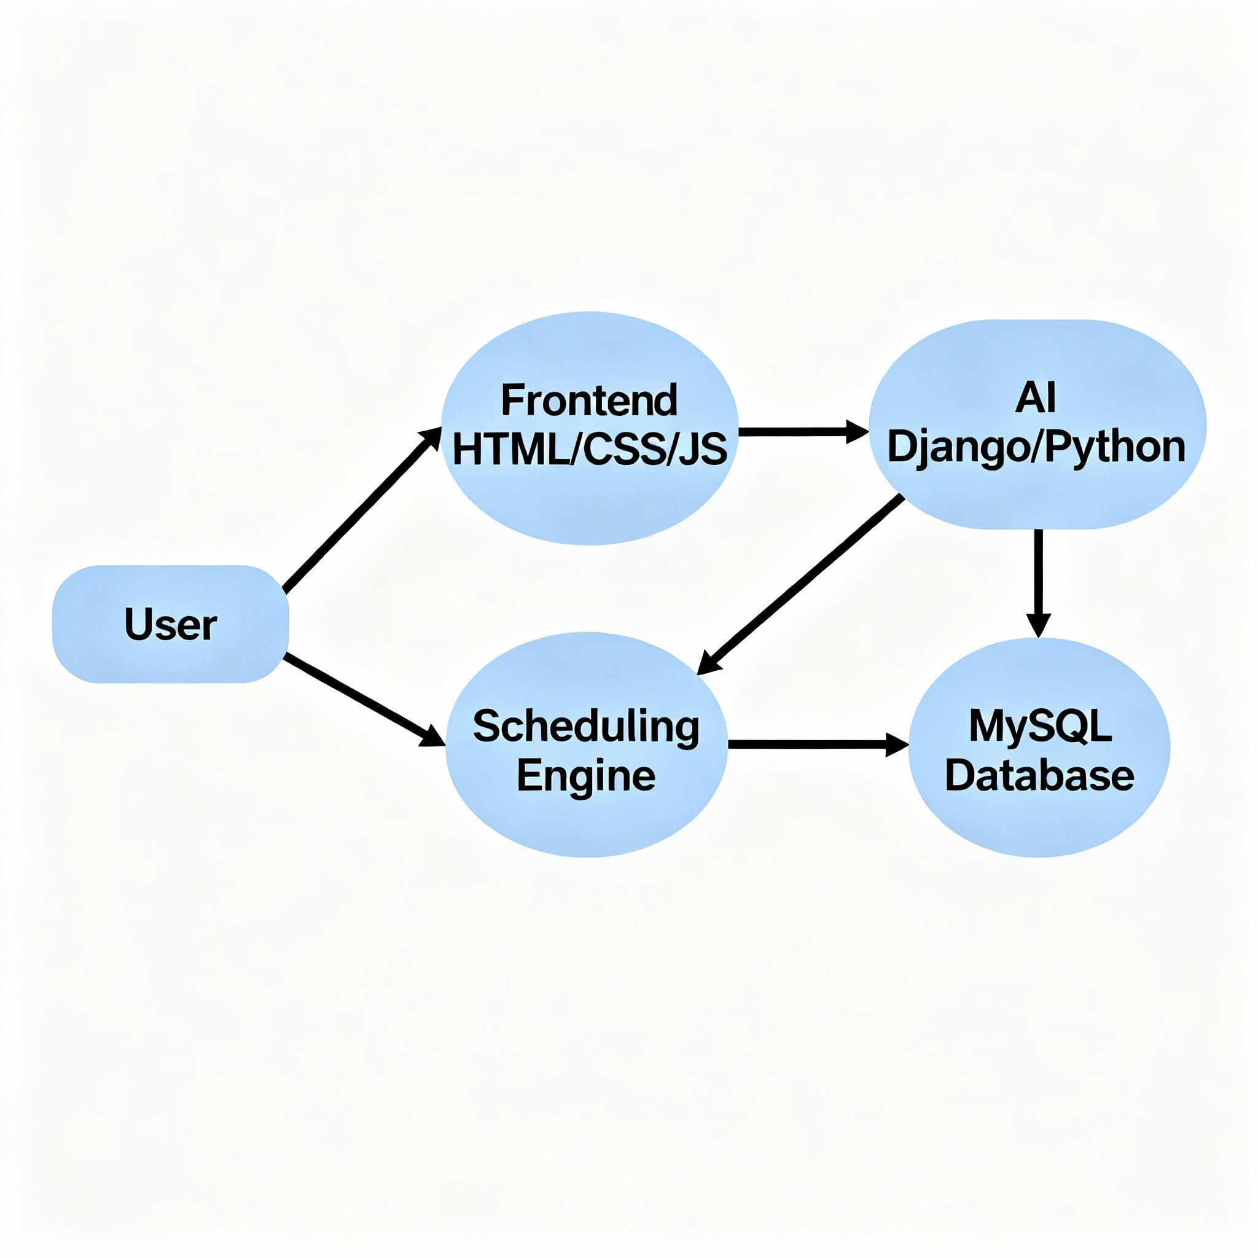
7. System Design – Architecture
Architecture Overview:
Frontend Layer: User interacts via browser (HTML/CSS/JS).
Backend Layer: Django handles business logic, AI scheduling algorithms, and communication with database.
Database Layer: MySQL stores details of faculties, courses, schedules, and configurations.
Data Flow:
User inputs → Django views → Scheduling module → Database updates → Generated timetable rendered on frontend.

Slide 11
8. Database (ER Diagram)
Main Entities:
Faculty (faculty_id, name, availability, department)
Course (course_id, name, duration, type)
Classroom (room_id, type, capacity)
Schedule (schedule_id, faculty_id, course_id, room_id, day, time_slot)
Relationships:
Faculty teaches multiple Courses (1‑to‑many).
Course assigned to a Classroom (1‑to‑1 or many‑to‑1).
Schedule links Faculty, Course, and Classroom with time constraints.
(ER Diagram visualization: faculty → course → schedule → classroom)

Slide 12
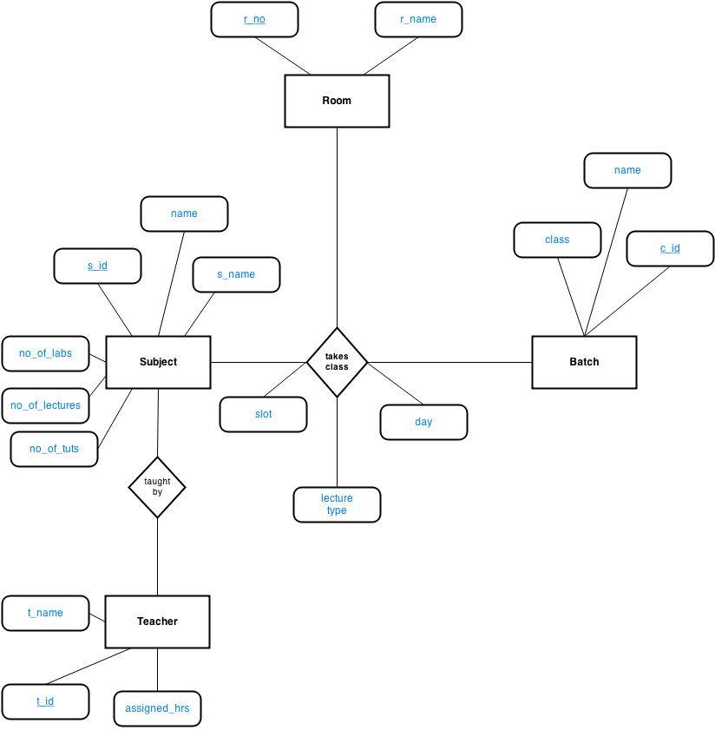

Slide 13
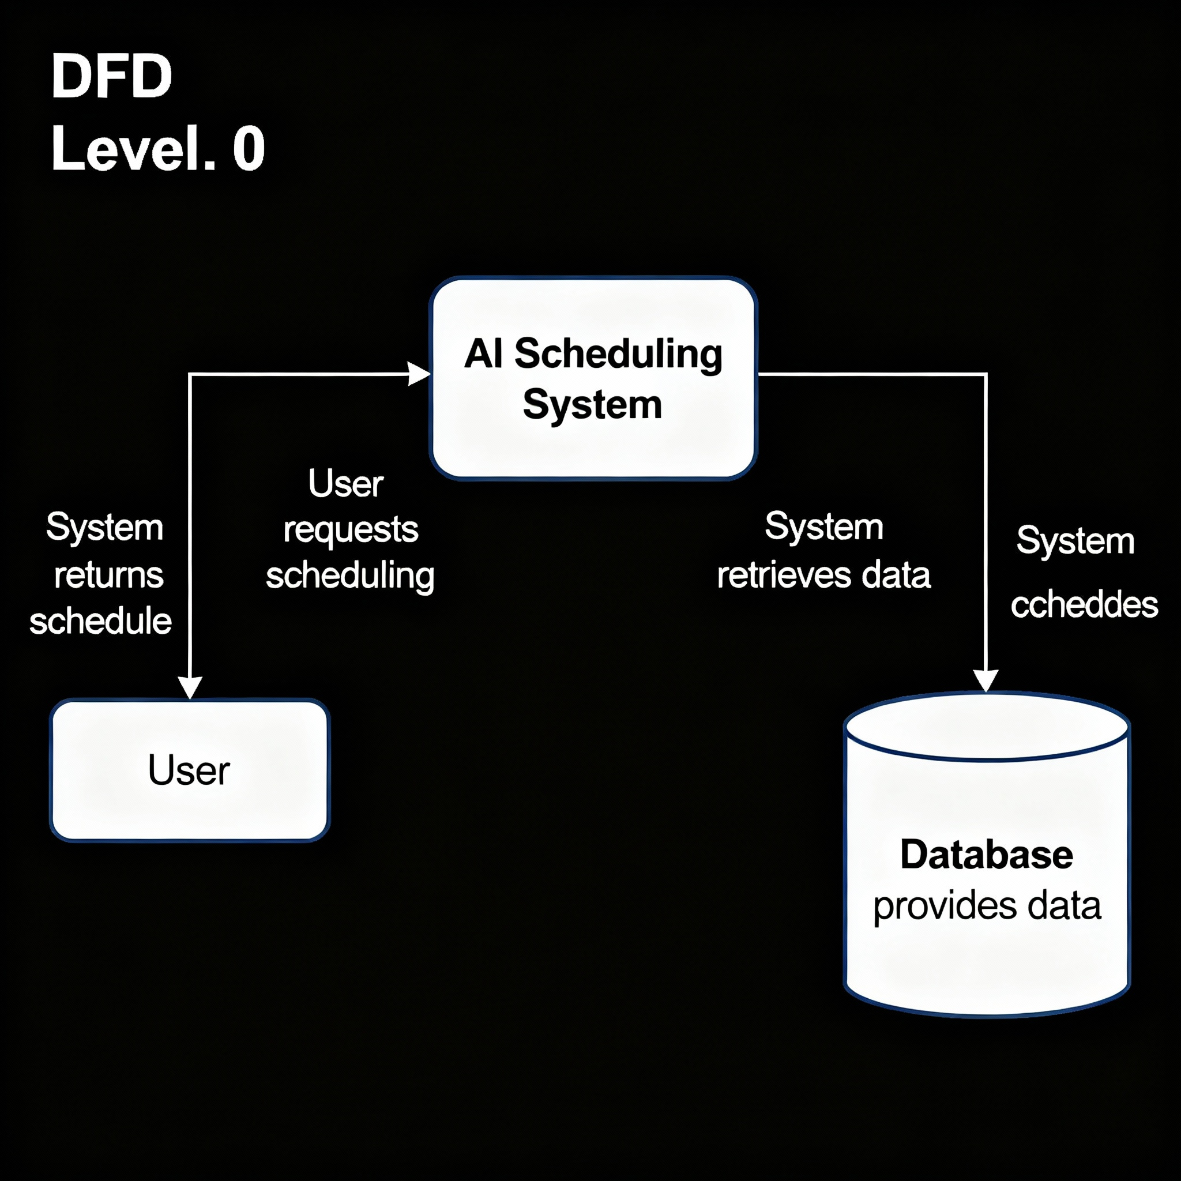
9. DFD Levels Flowchart
Level 0 (Context Diagram):
User → [AI Scheduling System] → Database.

Slide 14
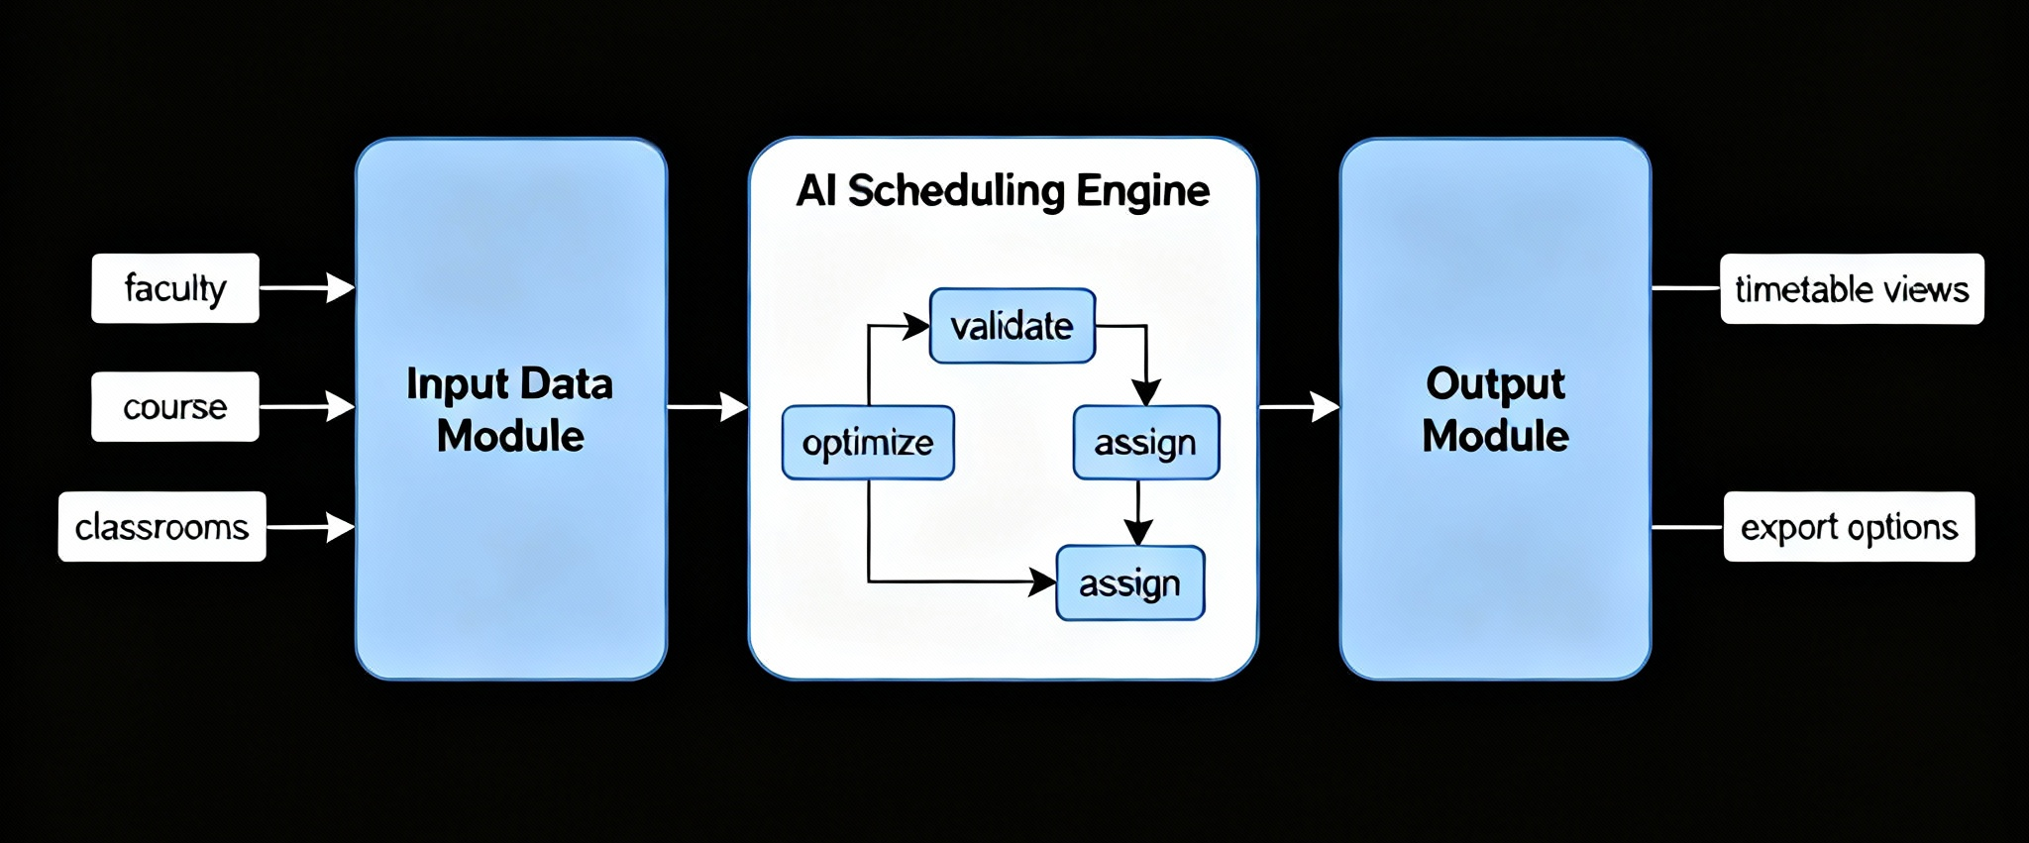
Level 1:
Input Data Module (faculty, course, classrooms).
AI Scheduling Engine (validate, optimize, assign).
Output Module (generate timetable view/export).

Slide 15
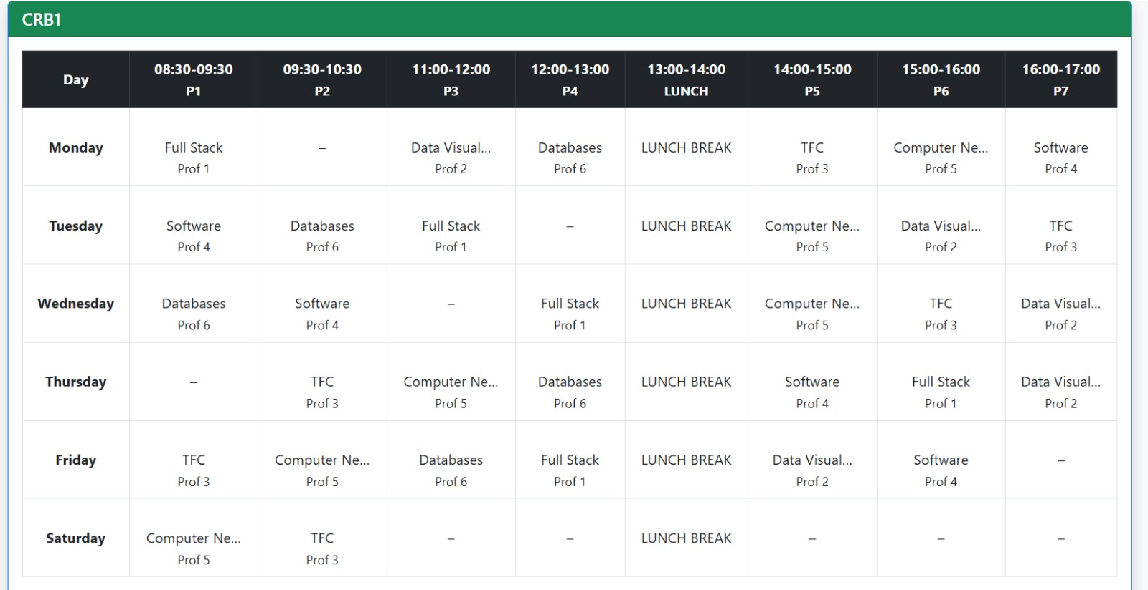
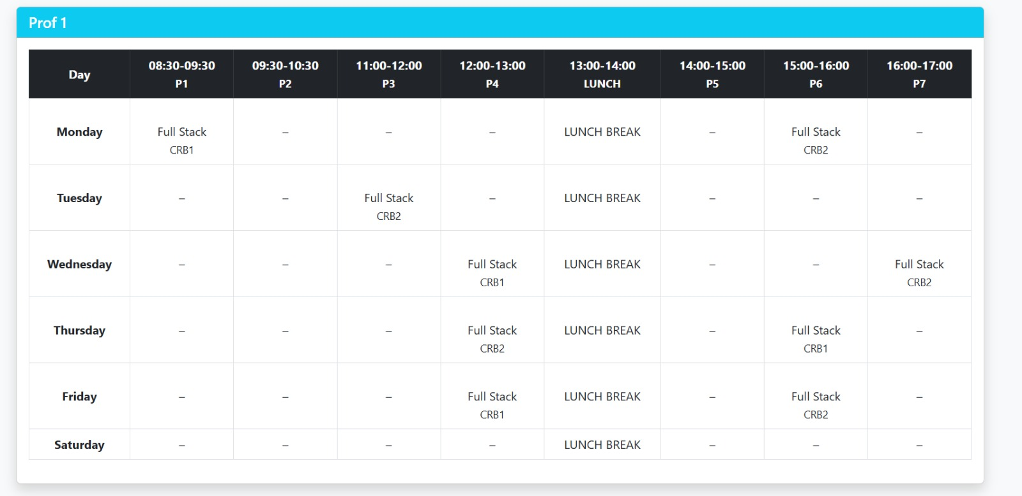
Outcome

Slide 16
10.Conclusion
The AI-Powered Class Scheduling System using the Django Framework provides an efficient and intelligent solution for generating academic timetables.
By integrating AI algorithms with a web-based interface, the system reduces manual effort, minimizes scheduling conflicts, and optimizes the use of classrooms and instructor availability.
The modular design ensures scalability, maintainability, and ease of use for administrators, faculty, and students.
Overall, this system enhances operational efficiency, improves academic planning, and demonstrates how modern technology can streamline complex educational processes.

